Slide 1
Introduction
Dr. Anwesha Aditya
IIT Kharagpur

Slide 2
What Is International Economics About?
International economics is about how nations interact through:
trade of goods and services, flows of money, and investment.
International economics is an old subject, but continues to grow in importance as countries become tied more to the international economy.
Nations are now more closely linked than ever before.

Slide 3
International Trade Versus Finance
International trade focuses on transactions involving movement of goods and services across nations.
- Gains from trade, explaining patterns of trade, effects of government policies on trade
International finance focuses on financial or monetary transactions across nations.
-Balance of payments, exchange rate determination, international policy coordination and capital markets

Slide 4
Three Basic Issues:
Causes,
Pattern and
Consequences of International Trade

Slide 5
Basis of Trade
First, when do countries engage in international trade in goods and services? What are the factors that drive goods and factors to flow from one country to the other?
Inter versus intra industry explanation

Slide 6
Patterns of Trade
Why do some countries export manufactured goods and others export agricultural goods?
Differences in climate and resources can explain why Brazil exports coffee and Australia exports iron ore.
But why does Japan export automobiles, while the U.S. exports aircraft?
Why some countries export certain products can stem from differences in:
Labor productivity
Relative supplies of capital, labor and land and their use in the production of different goods and services

Slide 7
Gains from Trade
Normative issue: whether international exchange and trade are always gainful for countries.
Under certain market and technological conditions, international exchange of goods and services by atomistic agents raises national welfare of all trading nations if such exchanges follow the principles of comparative advantage.

Slide 8
Free Trade versus Protection
Despite gains from trade, countries had often been observed to restrict trade through import tariffs and non-tariff barriers.
Policy makers affect the amount of trade through
tariffs: a tax on imports or exports,
quotas: a quantity restriction on imports or exports,
export subsidies: a payment to producers that export,
or through other regulations (ex., product specifications) that exclude foreign products from the market, but still allow domestic products.
What are the costs and benefits of these policies?

Slide 9
Size Matters: The Gravity Model
3 of the top 10 trading partners with the U.S. in 2008 were also the 3 largest European economies: Germany, U.K., and France, the countries having the largest gross domestic product (GDP) in Europe.
Why does the U.S. trade most with these European countries and not other European countries?

Slide 10
The Gravity Model (cont.)
In fact, the size of an economy is directly related to the volume of imports and exports.
Larger economies produce more goods and services, so they have more to sell in the export market.
Larger economies generate more income from the goods and services sold, so they are able to buy more imports.

Slide 11
The Gravity Model (cont.)
In its basic form, the gravity model assumes that only size and distance are important for trade in the following way:
T_{ij} = A x Y_{i} x Y_{j} /D_{ij}
where
T_{ij} is the value of trade between country i and country j
A is a constant
Y_{i} the GDP of country i
Y_{j} is the GDP of country j
D_{ij} is the distance between country i and country j

Slide 12
Distance and Borders (cont.)
Besides distance, borders increase the cost and time needed to trade.
Trade agreements between countries are intended to reduce the formalities and tariffs needed to cross borders, and therefore to increase trade.
The gravity model can assess the effect of trade agreements on trade: does a trade agreement lead to significantly more trade among its partners than one would otherwise predict given their GDPs and distances from one another?

Slide 13
Has the World Become “Smaller”?
The negative effect of distance on trade according to the gravity models is significant, but has grown smaller over time due to modern transportation and communication.
Technologies that have increased trade:
Wheels, sails, compasses, railroads, telegraph, steam power, automobiles, telephones, airplanes, computers, fax machines, Internet, fiber optics, personal digital assistants, GPS satellites…

Slide 14
Has the World Become “Smaller”? (cont.)
Political factors, such as wars, can change trade patterns much more than innovations in transportation and communication.
World trade grew rapidly from 1870 to 1913.
Then it suffered a sharp decline due to the two world wars and the Great Depression.
It started to recover around 1945 but did not recover fully until around 1970.
Since 1970, world trade as a fraction of world GDP has achieved unprecedented heights.

Slide 15
Virtual Trade
Breakthrough in information and communication technology has enabled many previously non-traded services tradable.
Virtual trade arising due to time zone difference has very recently emerged as the fourth dimension of determining trade patterns among countries (Marjit, Mandal and Nakanishi, 2020).

Slide 16
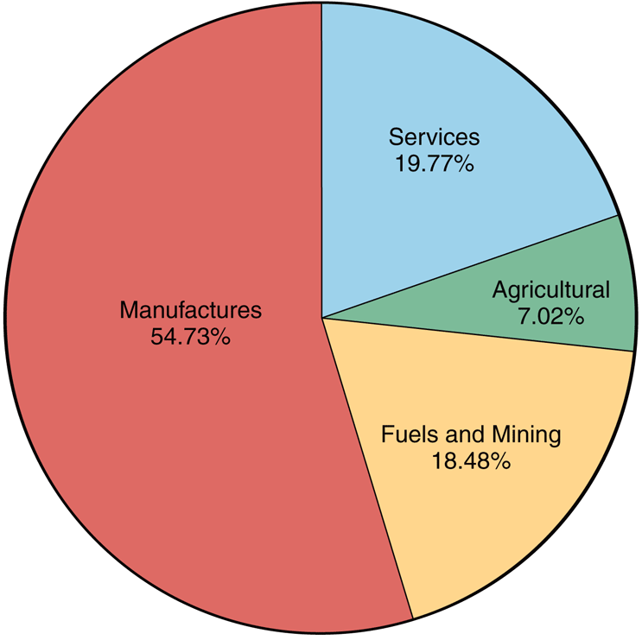
The Composition of World Trade, 2008
Source: World Trade Organization

Slide 21
Course Outline

Slide 22
Introduction | What does International Economics Study? International Trade versus Finance Three Basic Issues: Causes, Pattern and Consequences of International Trade Changing composition of World Trade Size matters: The Gravity Model
Topic 1 | Basis of Trade (Inter-Industry)
1.1 | Arbitrage and Inter-Industry Trade
1.2 | Comparative advantage Fundamental sources Public Policy and Induced Comparative Advantage Selective Factor Disadvantage, Innovations and Shifting Comparative Advantage
 | Revealed Comparative Advantage
Topic 2 | Gains from Trade
2.1 | Trade, Gains and Redistribution
2.2 | Resource Reallocation and Gains from Trade

Slide 23
Topic 3 | Determination of Terms of trade
3.1 | Offer curves
3.2 | Backward Bending Offer Curve
3.3 | Offer Curves under Constant Opportunity Cost
3.4 | International Equilibrium
3.5 3.6 | Geometric measurement of the import demand elasticity along offer curve Existence, Uniqueness and Stability of International Equilibrium
Topic 5 | Technology and Trade
4.1 | Constant opportunity cost, technology and trade
4.2 | Relative Sizes of Trading Nations and Distribution of GFT
Trade Theories

Slide 24
Topic 4 | Factor Endowment and Trade
4.1 | Assumptions and the structure of HOS model
4.2 | Autarchic Equilibrium and the Pattern of Trade
4.3 | Two Properties of the model: Output and Price Magnification Effects Endowment shock and output changes: Output magnification effect or Rybczynski theorem Price magnification effect Algebraic derivation of the relative supply curve
4.4 | Factor Prices at Post-trade equilibrium
4.5 | Empirical tests of the HO theorem: Leontief paradox
4.6 | Factor content and HOV theorem

Slide 25
Topic 5 | Theories of Intra-Industry Trade
5.1 | IIT in identical products
5.2 | IIT in horizontally differentiated products Love for Variety: Monopolistic Competition and IIT in Differentiated Goods: Krugman (1979) Characteristics approach
Topic 6 | Import Tariff and Export Subsidies
6.1 | Economic Effects of an Import Tariff: A partial equilibrium analysis
6.2 | Revenue Motive and Revenue Maximizing Tariff
6.3 | General Equilibrium Analysis: TOT and Volume of Trade (VOT) Effects Change in output, consumption and volume of trade for a small economy TOT effect, Welfare Change and the Optimum Tariff for a Large Country Tariff Retaliation and Trade War among Countries
6.4 | Export Subsidy, TOT deterioration and Welfare Loss
Topic 7 | Quantitative Restrictions, NTBs and Equivalence
7.1 | Import quota, Implicit Tariff and scarcity rent
7.2 | Voluntary Export Restraints
7.3 | Other Non Tariff Barriers
Topic 8 | WTO Issues

Slide 26
References
Acharyya, R., International Economics: An Introduction to Theory and Policy, Oxford University Press.
Caves, R. E., J. Frankel and R.W. Jones, 1995, World Trade and Payments, Harper and Collins.
Krugman, P. R. and M. Obstfeld, International Economics: Theory and Policy, Pearson Education.

